Slide 1
AIR FARE PREDICTION Capstone Interim Report –Review by Dr. Basu
Group -4 / Batch - February 2020
Mentor Team Members
Mr. Pranov Mishra Bala Pranav Shanth U
Prashanth S
Vijayaraghavan S
Swetha R
Pavithra Doraisamy

Slide 2
PROBLEM STATEMENT
Predicting Airfare for the routes in Europe continent considering various parameters such as Origin Country, Destination Country , Origin City , Destination City, Journey day, date difference between journey day from booking day, travel duration ,etc. in-order to enable the passengers to reserve their tickets at better fare
In the best interest of time and computational usage, we have considered only Euro as our Fare Currency in the Fare Currency column. The data has been collected from the website www.Reddit.com in-order to perform our analysis.

Slide 3
DATA DESCRIPTION
The Total size of the raw dataset is 300 MB, consisting of 46 columns and around 725776 rows. The Data consists of 29 Categorical/Discrete/Date features and 17 continuous features. The Fare Amount is our dependent variable and all other variables will be considered as independent variables.

Slide 4
DATA DICTIONARY (Categorical/Discrete Variables)
FEATURES | DESCRIPTION
Origin Country | Flight Departure Country
Destination Country | Flight Arrival Country
Origin city | Flight Departure City
Destination city | Flight Arrival City
Fare Class | Ryanair Fare Class
Fare Currency | Type of currency
Flight key | Best I can tell is that this is the closest thing to a unique key that Ryanair published about each flight
Fare Key | Similar to the flight key, this denotes unique fares found these are not unique in the dataset though, they are repeated regularly
Fare Type | What type of fare, all Adult fares in this dataset
Fare has Promo | Promo code information T/F
Fare Published | 'sticker price', without discounts
Fare Discounted | T/F if it is discounted
Segment origin | Connecting Departure airport
Segment destination | Connecting arrival airport

Slide 5
DATA DICTIONARY (Categorical/Discrete Variables)
FEATURES | DESCRIPTION
Origin Airport Name' | Airport name of the Departure city
Destination Airport Name' | Airport name of the arrival city
'Origin_ICAO Code' | Departure airport code
'destination_ICAO Code' | Arrival airport code
'Origin Airport Code' | Departure airport code
'Destination_AirportCode' | Arrival airport code
'Destination Altitude' | Altitude of the arrival airport
'Origin Altitude' | Altitude of the Departure airport
'Destination longitude | Longitude of the arrival airport
'origin longitude' | Longitude of the Departure airport
'Route Origin Name' | Departure airport name
'Route Origin Airport | Departure g airport name
'Route Destination Name' | Arrival airport name
'Route Destination Airport' | Arrival airport name
Segment Flight Number | Flight number which reach arrival point with connecting cities
Segment number | Connecting city number

Slide 6
DATA DICTIONARY (Continuous/Date time Variables)
FEATURES | DESCRIPTION
Segment flight duration | Duration of Connecting cities
Route Origin Time | Departure time
Route Destination Time | Arrival time
Origin Time zone | Departure city time zone
Destination Time zone | Arrival city time zone
Segment origin time local | Local time of the connecting Departure place
Segment destination time local | Local time of the connecting arrival place
Segment origin time UTC | UTC time of the connecting Departure place
Segment destination time UTC | UTC time of the connecting arrival place
Request time UTC | Date/Time that the request for the segment/fare was made.

Slide 7
DATA DICTIONARY (Continuous/Date time Variables)
FEATURES | DESCRIPTION
Booking Date | Enquiry Date for journey
Date | Journey date
Flight Duration | HH:MM
Fare discount Pct. | percentage discount in the 'Fare Amount'
Segment Distance (Km) | Not in nautical miles
Fare Amount | Final Fare Amount, including any discounts

Slide 8
DATA PREPROCESSING
Handling Null Values
As we are having only 2.66% of the data points as null values we are dropping the null values directly because it is not going to affect our prediction model
Handling Outliers
Outliers will naturally affect the prediction model because of the extreme high and low values, so for handling it we used a method in which we have capped the values Q3+(1.5 * IQR) and Q1-(1.5 * IQR) as upper range and lower range values respectively to remove the outliers form the data
Total Number of Null Value data | 19317
Total percentage of Null Values in the data | 2.66

Slide 9
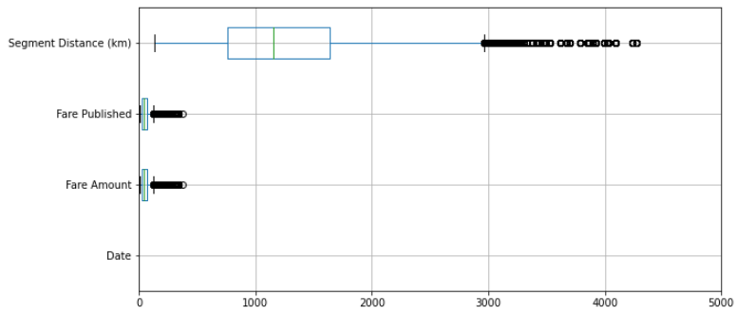
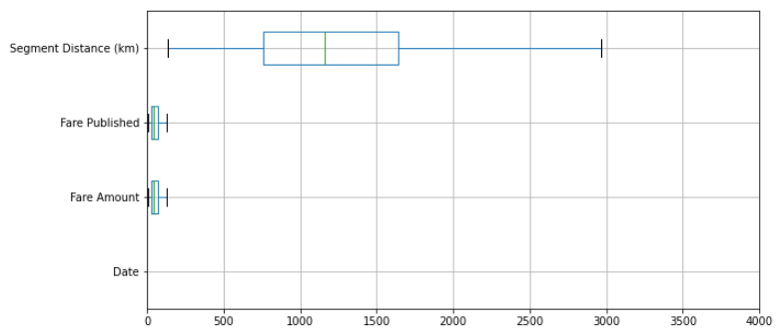
BOXPLOT
Before Handling Outlier
After Handling Outlier

Slide 10
FEATURE SELECTION
Inferences on Dropping the columns
a. Fare Discount Pct. and Fare Discounted : Columns are dropped because we are having around 91% of the rows as 0, so it will not contribute well to our model
b. Destination Airport Name/Destination City/ICAO Destination/Route Destination Airport/segment destination , Origin City/Origin Airport Name/Route origin airport/ICAO origin airport/segment origin - both columns shares the same information so we are removing one column
c. Booking date and Request time UTC - shares the same info so dropping one column
d. Segment origin time/segment origin time UTC/segment destination time local/segment destination time UTC/'Segment Flight Number'/'Segment Origin'/'Segment Destination'/'Segment Duration' - are dropped because it has no meaning as Ryanair flight company does not has connecting flight services
e. Destination-Latitude'/'Destination Longitude'/'Destination Altitude'/'origin Latitude‘/'origin Longitude‘/'origin Altitude' - this information does not contribute information for our flight fare prediction purpose.
f. Flight Key -Best I can tell is that this is the closest thing to a unique key that Ryanair published about each flight. this column is dropped because it has unique values for each row so no information form this column
g. Fare Key - it gives the unique values of the different fare ranges , so this column has the same information as of the dependent variable so we are dropping this column.
h. Origin Time zone/Destination Time zone - have only constant value so we are dropping these columns
i. Fare Currency column is dropped because other unique values are dropped and only EURO type currency is considered for our model as it contributes 72% of the data point s and due to computational time effeciency

Slide 11
FINAL FEATURES & SHAPE (After Feature selection for the Analysis)
DESCRIPTION | SHAPE
Total number of columns | 11
Total number of rows | 504606
Features | Data Types
Booking Date | Date time
Date | Numerical
Origin Country | Discrete
Destination Country | Discrete
Origin city | Discrete
Destination city | Discrete
Fare Class | Discrete
Fare Currency | Discrete
Flight Duration | Date time
Fare Type | Discrete
Fare Published | Numerical
Fare Amount | Numerical
Segment Distance (Km) | Numerical

Slide 12
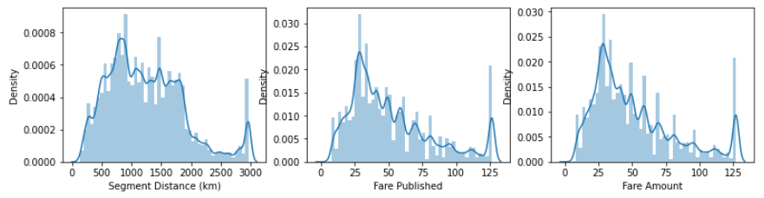
DATA DISTRIBUTION
From Histogram diagram
a. Segment distance (km) Column is having close to normal distribution
b. Fare Amount and Fare Published columns are having right skewed distributions

Slide 13
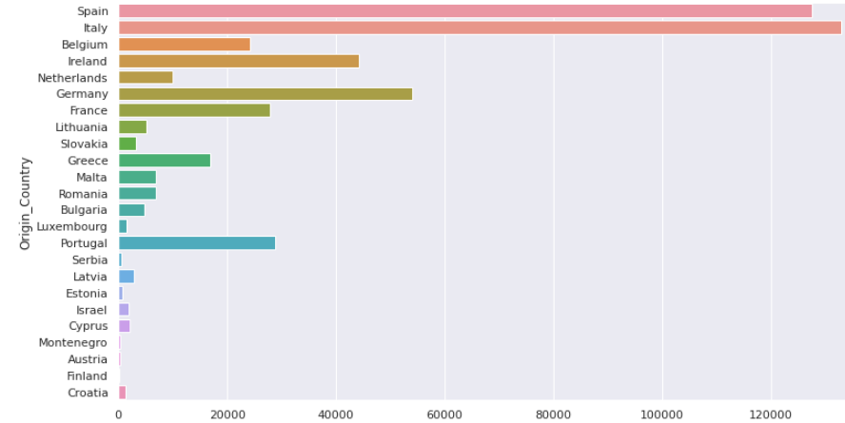
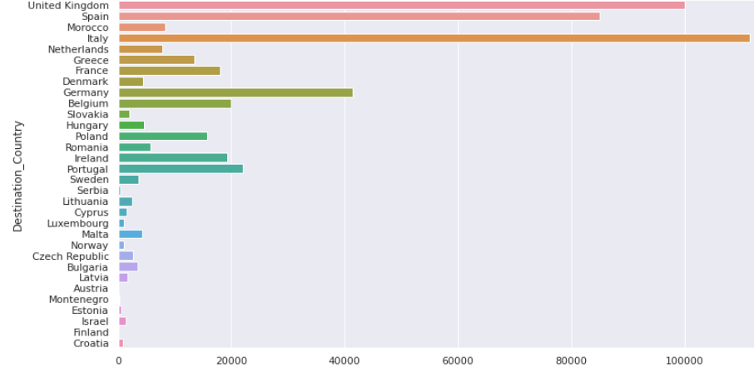
UNIVARIATE ANALYSIS
Destination Country
From the graph we can find that Italy has the highest data count in destination country
Origin Country
From the graph we can find that Italy has the highest data count in origin country

Slide 14
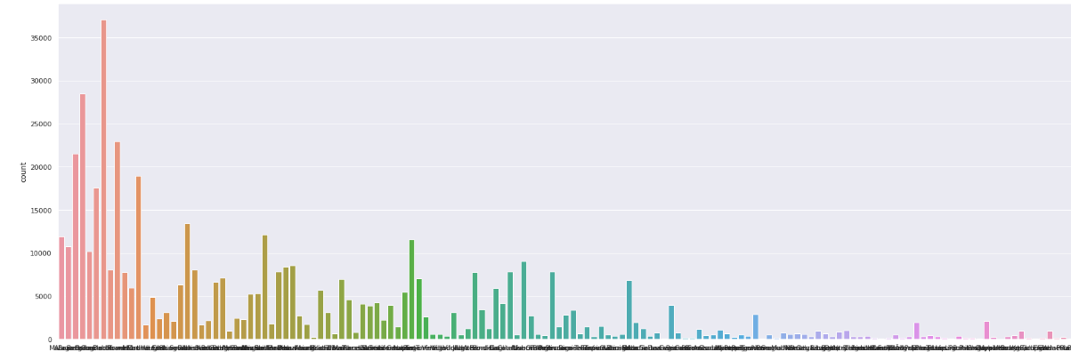
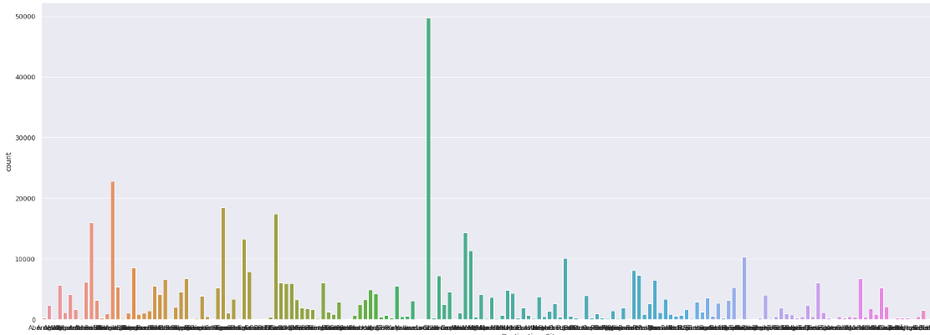
UNIVARIATE ANALYSIS
Origin City
From the graph we can find that Dublin has the highest data count in origin city
Destination City
From the graph we can find that London has the highest data count in Destination City

Slide 15
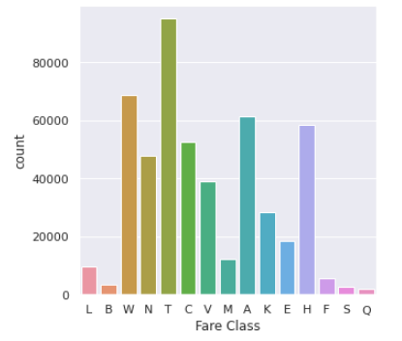
UNIVARIATE ANALYSIS
Fare Class
From the graph we can find that fare class T has the highest data count

Slide 16
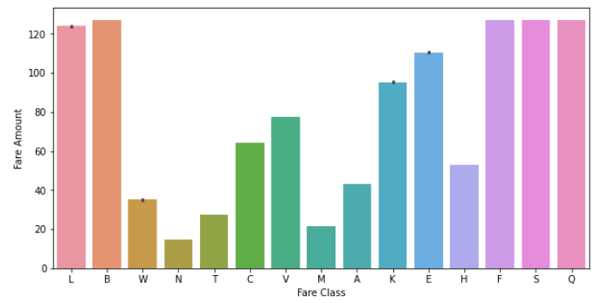
BIVARIATE ANALYSIS
Fare class vs Fare Amount
From the graph we can find that the Fare classes B,F,S,Q has highest Fair Amounts compared to other Fare Classes

Slide 17
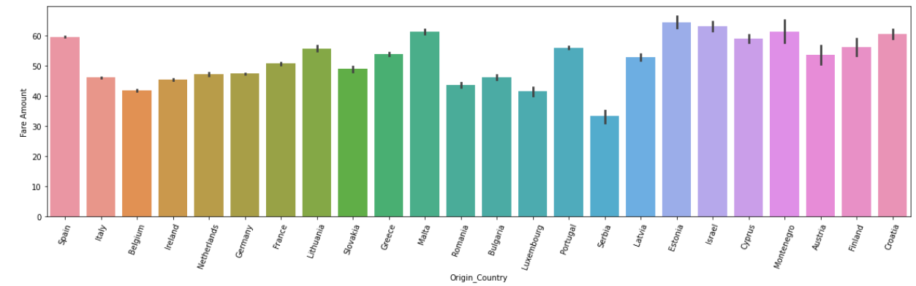
BIVARIATE ANALYSIS
Origin Country Vs Fare Amount
From the graph we can find that the Origin Country Estonia has highest Fair Amount compared to other Origin Country

Slide 18
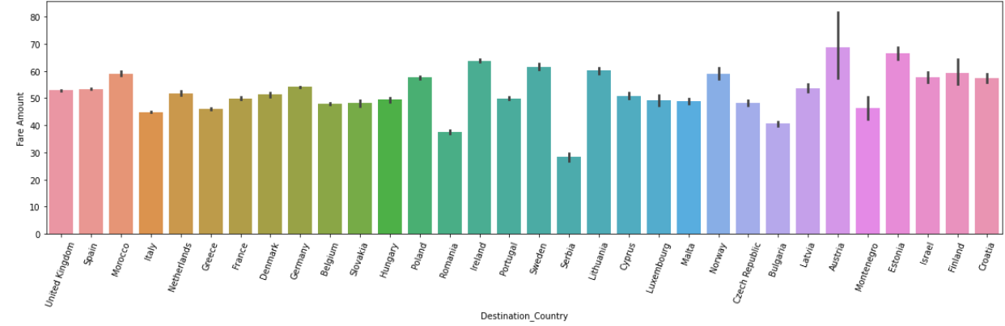
BIVARIATE ANALYSIS
Destination Country Vs Fare Amount
From the graph we can find that the Destination Country Austria has highest Fair Amount compared to other Destination Country

Slide 19
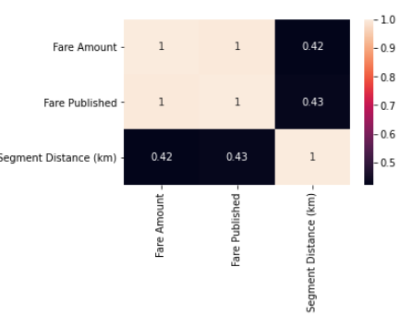
BIVARIATE ANALYSIS (Correlation Analysis)
Heat Map
a. From the heat map we can find that there is good correlation b/w Independent variable and Dependent Variables
b. Correlation magnitude b/w Independent variables are not so strong
VIF Score
From the VIF score we can infer that the variance of one numerical independent variable is not projected by other numerical independent variable
Fare Published | VIF = 1.23
Segment Distance (km) | VIF = 1.23

Slide 20
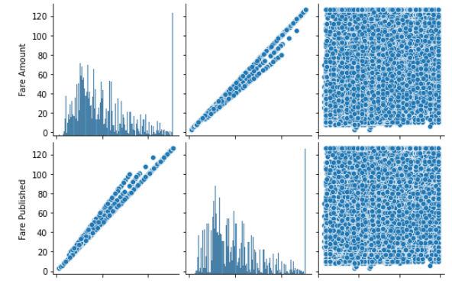
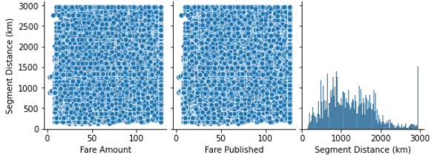
MULTIVARIATE ANALYSIS
Pairplot

Slide 21
FEATURE ENGINEERING
Feature Engineering is a method to modify the categorical variables into continuous variable for the understanding of variables to the machines for performing our predictive modelling.
Techniques used for our dataset
One – Hot Encoding
Frequency encoding
Date time encoding
Below are the Features need to be encoded into numerical variables
FEATURES | VALUE COUNTS
Date | 355
Booking Date | 1
Flight Duration | 95
Origin Country | 24
Origin City | 148
Destination Country | 32
Destination City | 186
Fare Class | 15

Slide 22
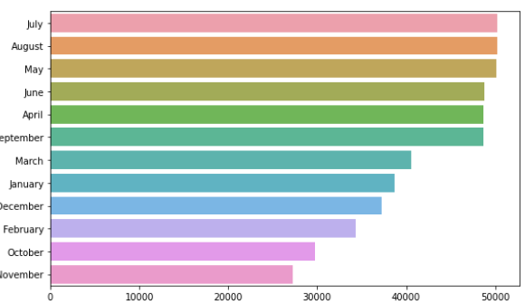
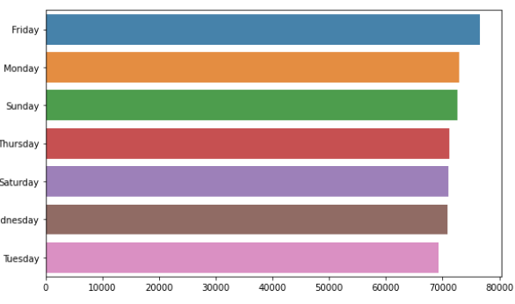
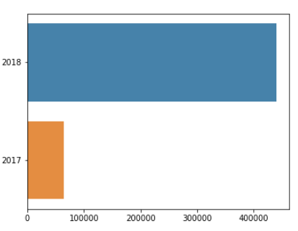
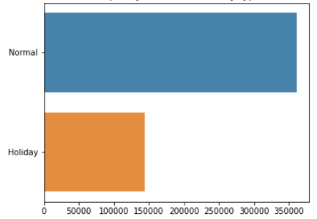
FEATURE ENGINEERING (Date Column)
Please find the below the graphical representation of the new columns [‘Journey Month', 'Journey day', 'Journey year', 'Journey day type’] respectively, which has been extracted after Encoding the Date Column

Slide 23
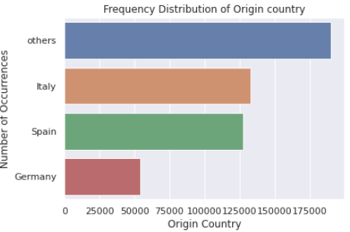
FEATURE ENGINEERING (Origin Country)
Total unique Values of Origin Country Column is but we have considered only the four unique country value because it contributes around 71% of the data points in the column and named other country names as ‘others’
Below graph represents the encoded changes done
UNIQUE VALUES | PERCENTAGE
Italy | 26.328660
Spain | 51.582423
Germany | 62.273933
Ireland | 71.041763

Slide 24
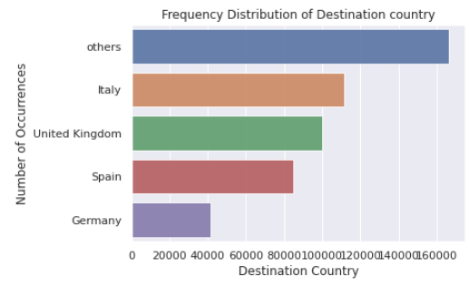
FEATURE ENGINEERING (Destination Country)
Total unique Values of Destination Country Column is but we have considered only the four unique country value because it contributes around 67% of the data points in the column and named other country names as ‘others’.
Below graph represents the encoded changes done
UNIQUE VALUES | PERCENTAGE
Italy | 22.105762
United Kingdom | 41.941634
Spain | 58.770209
Germany | 66.986520

Slide 25
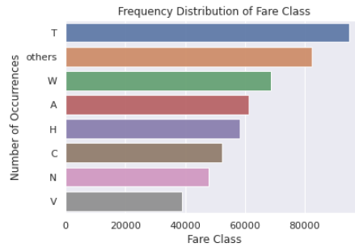
FEATURE ENGINEERING (Fare Class)
Total unique Values of Origin Country Column is but we have considered only the seven unique Fare Class value because it contributes around 83% of the data points in the column and named other country names as ‘others’.
Below graph represents the encoded changes done
UNIQUE VAULES | PERCENTAGE
T | 18.801005
W | 32.410039
A | 44.560310
H | 56.105952
C | 66.482761
N | 75.953913
V | 83.687867

Slide 26
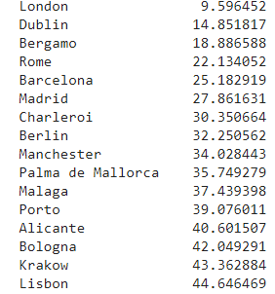
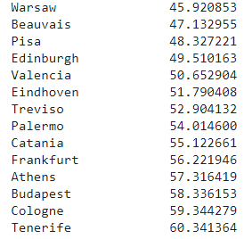
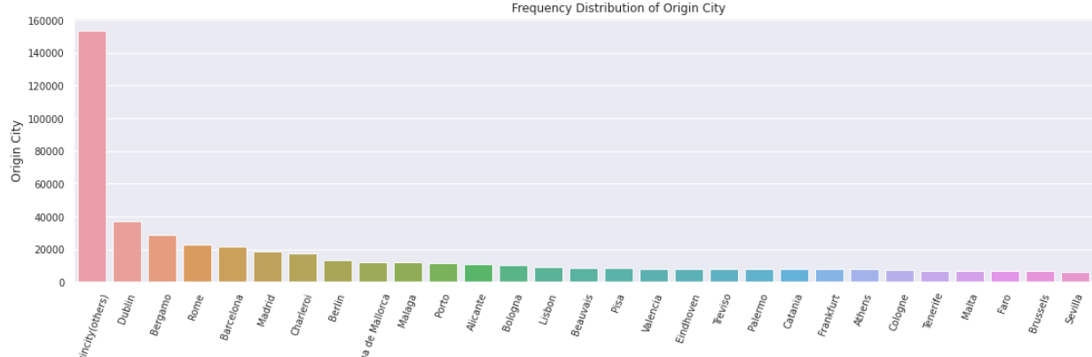
FEATURE ENGINEERING (Origin City)
Total unique Values of Origin City Column is but we have considered only the thirty unique city value from 200 values because it contributes around 60% of the data points in the column and named other city names as ‘others’.
Below graph represents the encoded changes done

Slide 27
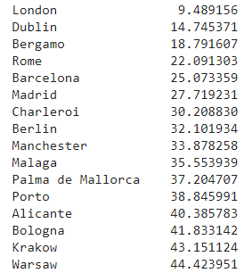
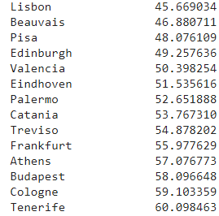
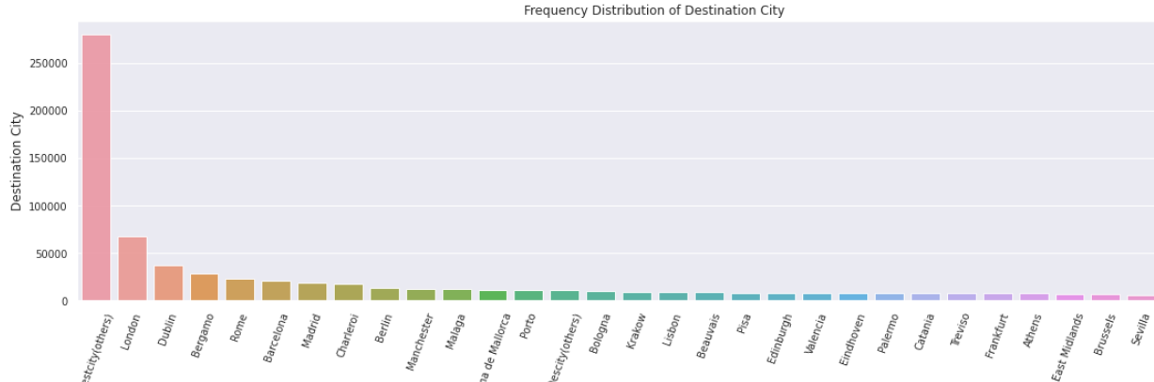
FEATURE ENGINEERING (Destination City)
Total unique Values of Destination City Column is but we have considered only the thirty unique city value from 200 values because it contributes around 60% of the data points in the column and named other city names as ‘others’.
Below graph represents the encoded changes done

Slide 28
FEATURES AND SHAPE (After Feature Engineering)
After Feature engineering the dataset consists of 99 columns and 504606 rows. The Data consists of float64(3), int64(2), int8(1), uint8(94). The Fare Amount is our dependent variable and all other variables will be considered as independent variables.
Total number of Features | 99
Total number of rows | 504606

Slide 29
INFERENTIAL ANALYSIS (CHI 2 - Test of Proportions)
Test of Proportions
The Test is done to infer on the proportions of each group in the categorical column. So from the below chart the P value is <0.05 for all variables so there is no equal proportion of groups in the categorical columns
FEATURES | P VALUE
Destination Country | 0.0
Destination City | 0.0
Origin Country | 0.0
Origin City | 0.0
Fare Class | 0.0

Slide 30
INFERENTIAL ANALYSIS (ANOVA Test)
Two Way Anova Test
The two-way analysis of variance is an extension of the one-way ANOVA that examines the influence of two different categorical independent variables on one continuous dependent variable.
H0: All the population mean are equal
H1: At least one of the population mean is not equal
Below table represents the Anova test representation for Date time type Columns.
a. So from the P value we Reject H0 infer that Day type/Journey Year/Journey month/Journey weekday individually does not affect the Fare amount
b. But during the interaction b/w the variables it affects the Fare Amount
FEATURES | ANOVA P- VALUE
Day_type | 0.991684
Journey_year | 1.000000
Journey_month | 1.000000
Journey_weekday | 1.000000
Day_type:CJourney_year | 0.041083
Journey_month:Journey_weekday | 0.040756
Journey_month: Day_type | 0.040057
Day_type: Journey_weekday | 0.241995
Journey_month: Journey_year | 0.247459
Journey_year: Journey_weekday | 0.039244

Slide 31
INFERENTIAL ANALYSIS (ANOVA Test)
Two Way Anova Test
The two-way analysis of variance is an extension of the one-way ANOVA that examines the influence of two different categorical independent variables on one continuous dependent variable.
H0: All the population mean are equal
H1: At least one of the population mean is not equal
Below table represents the Anova test representation for Categorical type Columns (without Interaction)
So from the P value which is <0.05 (we reject H0) and we can infer that Fare Class/Destination City/Destination Country/Origin Country/Origin Country individually affect the Fare amount
FEATURES | ANOVA P- VALUE
Fare Class | 0.0
Destination City | 0.448425
Destination Country | 0.448425
Origin Country | 0.448425
Origin City | 0.448425

Slide 32
INFERENTIAL ANALYSIS (ANOVA Test)
Two Way Anova Test
The two-way analysis of variance is an extension of the one-way ANOVA that examines the influence of two different categorical independent variables on one continuous dependent variable.
H0: All the population mean are equal
H1: At least one of the population mean is not equal
Below table represents the Anova test representation for Categorical type Columns (with Interaction)
So from the P value which is <0.05 (we reject H0) and we can infer that Fare Class/Destination City/Destination Country/Origin Country/Origin Country affect the Fare amount during having interaction also
FEATURES | ANOVA P- VALUE
Destination_City : Origin City | 0.0413
Origin_Country : Destination Country | 0.0342
Origin_Country: Destination_City | 0.0321
Origin_Country : Origin City | 0.0245
Origin_Country : Fare Class | 0.0
Destination Country : Fare Class | 0.0
Destination_City : Fare Class | 0.0

